Slide 1
Infinity Services
By
Gohil Kushal and
Aanand Varun

Slide 2
INDEX
Introduction
System Analysis
Implementation Details
System Design
Output & Reports Testing
Conclusion and Recommendations
Future Scope
Bibliography and References

Slide 3
INTRODUCTION
Welcome today infinity where we are to serve you the most prominent professional services, these services are of your daily routine life.
Assume you have an important meeting with your boss in one hour, and you go to the bathroom to be fresh and what?
You got leakage in your tap, ohh! Now what to do this will be a great made as the meeting is very important if you don't know your boss will be angry over you and you can also lose your job but don't worry when you have Infinity services.
In this situation, you have just to go to the Infinity services portal and ask for the plumbing service and within a few minutes our service provider come to your location and check the situation and solve your problem so now you can go to the office within the time your boss will not angry you and make it to you so always remember what I will success person every person has Infinity service experience!!
Want to know more about Infinity services, so now go further in this documentation.
I must say you will have a very get fine with the knowledge about the services and how the Infinity services system work.
Ok, then it was just an introduction about the project system you can now plan over others' benefits and details about the project.

Slide 4
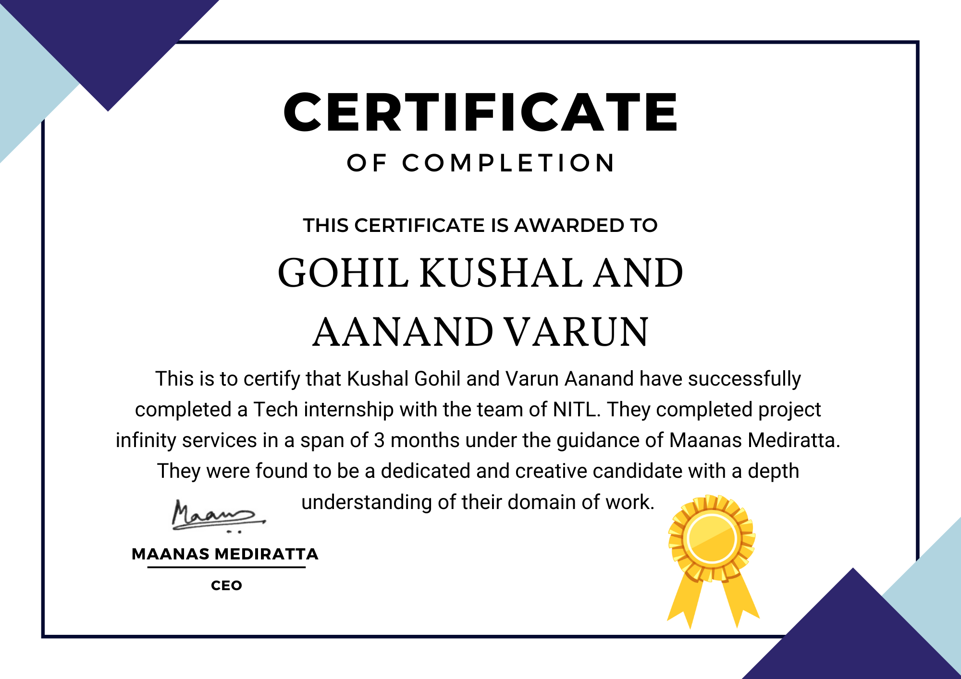

Slide 5
COMPANY PROFILE
Here is our company profile in which will get to know about how our company structure follows and what are the objectives on which we working,
History of the company - In the beginning, we were a service-based company and we used to develop software for small businesses but we got many queries from small service providers that we are running out of business and not able to go profitable so we thought about it and decided to develop a prototype where anyone as a user can book a service they need and service provider will get the respective orders as per his business type. We registered our startup in Spain Barcelona. Established in 2021 our startup has raised 200k dollars from investors in Pre Seed round. Our motive is to bridge the gap between a service provider and a consumer help user find good service and help the service provider by providing him orders on daily basis.

Slide 6
SCOPE OF SYSTEM
SYSTEM - BOUNDARY:
Existing system facilities and to sustain the market with a system for a particular locality as if you are from a particular location, for example, you can say you are from Mumbai then it will be easy for you to operate our system as we provide specialized our system for only a particular location of the user who logs into our system.
SYSTEM - END-USER:
The end-user of our application is a general public who won a service for their efficient work just like if you are a housewife or person come from out of town to the town which is not familiar with him so he can ask us where to go for the best hotel or if you are a person who needs a plumbing service you can contact us so in this scenario you can you state that our end-user is in a very large scale. It will be very beneficial for our service company
HOW IS THIS BUILT?
Please make sure to glance over the documentation, to get the answer of questions like how our system is built and what are the facilities and the services our system provide also you get to know about which study is done by us to deal with this awesome service application so let's go forward

Slide 7
NEED AND EXISTING SYSTEM
EXISTING SYSTEM:
Until now if we have any miscellaneous work of our home E.g. Plumbing, Painting, etc was done by the owner of the house himself or we used to call a person to do the work but most the people are busy in their office work and tend to have less time to monitor the service provider's work time to time and to keep a watch on his progress and charges of the service provider are high sometimes and as we know most of the people can't afford that.
NEED:
We need to fill this gap between user and service provider. We need some kind of place where users can book any service and get good quality service and assurance that if you have booked your service from this place you don't need to worry about quality and money all that will be solved by us.

Slide 8
PROPOSED SYSTEM
FOR WHO DID THE SYSTEM DESIGNED? :
As Mentioned Already to the System – End User Before, This Is Just To Emphasize It More Clearly,
Our application mostly targets the two different criteria of society.
Explaining in detail the first one is the service finder who wants or who is in the search of professional service and the other criteria is of the professional service providers who are mostly distributed or spread over the locality in a different location.
This makes what the criteria to come into one platform and access Each Other services
To clarify this let's take an example, if you are a car manufacturer and you are factory is on strike now what you will do you go to our portal and access the service of skilled professional workers it just like outsourcing

Slide 9
PROPOSED SYSTEM
HOW THIS SYSTEM WORKS? :
This application works on three categories of users:
The user who want the service will come to us and request for service after the acceptance from the service provider he can access the service within a few minutes
The service provider gets the facility of platform for his service he can manage his profile and accept this request from the service consumer he has an opportunity to make or to build communication for the consumer with chat or direct contact.
And admin panel will help the admin to optimize the application and also give them information about the services provided by the service provider and the user access to which type of case services on particular date or time and how much the service provider recharge if it is not in the objective defined by the admin he can alter it by its own

Slide 10
FEASIBILITY STUDY
TECHNICAL FEASIBILITY:
The technical aspect is the most important part of the system development. As the system is web-based. HTML, CSS, JavaScript is used to develop the interface and PHP for the functions with the database. For the database aspect, MySQL will be used which will link the system interface with the data storage. The exposure gained in the ‘business system development’ subject through the course curriculum has given us the credibility to develop the program as specified. Moreover, online tutorials on system development are also vastly available on the internet which will help us in the development stage.

Slide 11
FEASIBILITY STUDY
ECONOMICAL FEASIBILITY:
Basic analysis has been done in investigating the economical feasibilities of the project. the financial analysis demonstrates that the new system will reveal positive economic feasibility. In terms of software design and license, It can be found the open-source on the internet thus, the owner does not need to purchase the software from the vendor. The new system will be requiring extra cost on the hardware implementation part. In terms of special staff training, the new system will not need any extra cost. Normally, the newly developed system will need special training for the user, however in this case the system handling part is very easy and eliminate the need for training. Besides, a friendly interface makes staff work with less stress.
OPERATIONAL FEASIBILITY:
The risk of familiarity with the application is medium because the users/staff never used to computerized system. thus, there is a need for a brief introduction on handing the system to implement the system. Besides, as most of the staffs in the store are not IT literate.

Slide 12
FACT FINDING TECHNIQUE
QUESTIONARIES:
We have to design a questionnaire and provided them to the general public asking questions related to problems in their routine life when they get stuck into a situation like where they want the service by plumbing cleaner and any other services. Based on this question we design the objective and the boundary of the system
GROUND-LEVEL ANALYSIS:
The application also target the social criteria of service provider depending upon another one service provider that means to say a business to business communication, for that we provide a ground analysis in our own company when the company won Outsourcing services for our IT infrastructure we go to the IT service providers this makes us acknowledge about how dependency work in a business level

Slide 13
SOFTWARE AND HARDWARE REQUIREMENT
Processor:- Intel Pentium+
RAM:- 2GB+
Hard Disk:- 10GB+
Operating System:- Windows, Mac, Linux, UNIX, Raspberry Pi, Etc
Front-End Tech used:- HTML, CSS, JavaScript
Back-End Tech used:- PHP , MySQL

Slide 14
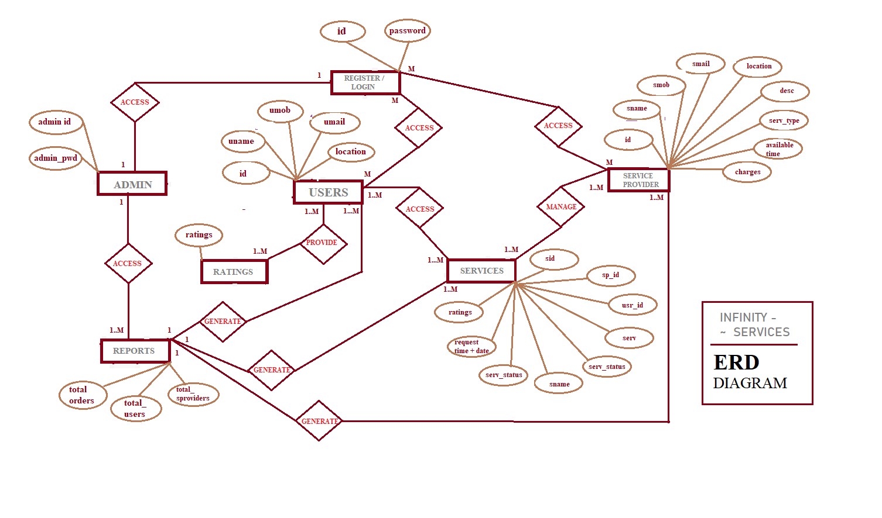
ERD

Slide 15
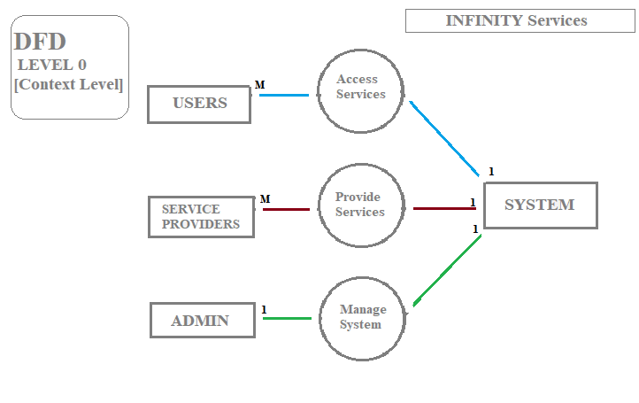
DFD LEVEL - 0

Slide 16
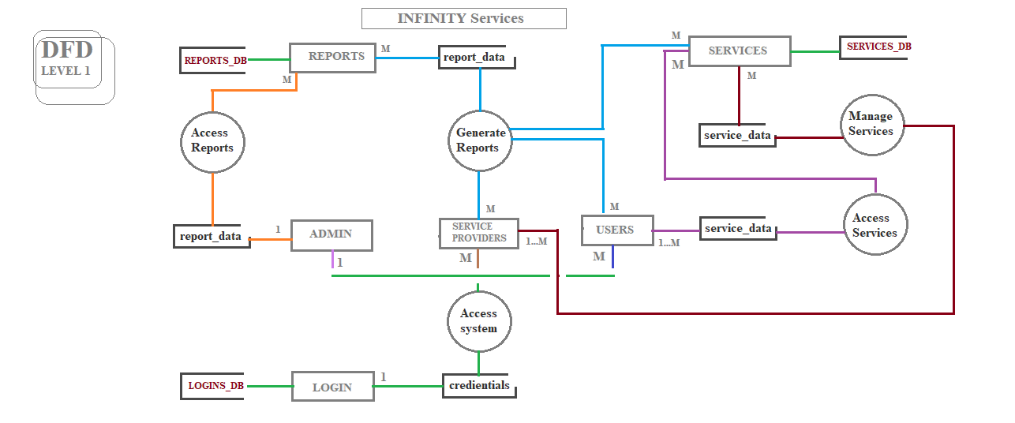
DFD LEVEL - 1

Slide 17
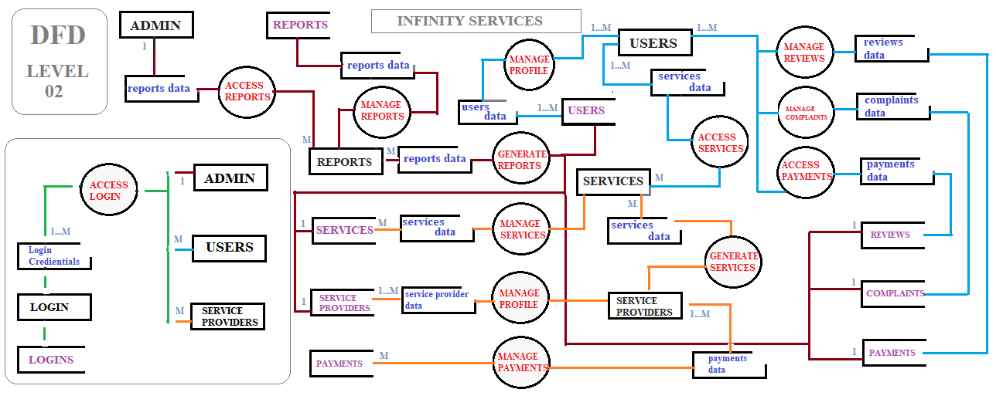
DFD LEVEL - 2

Slide 18
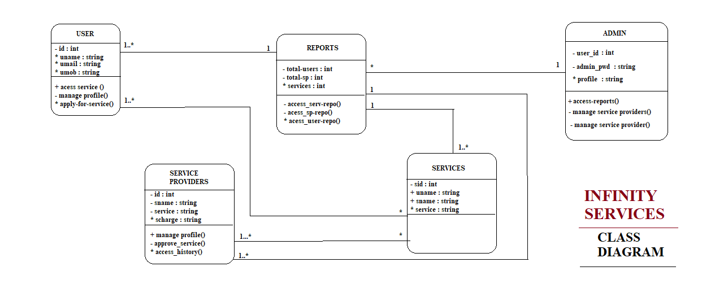
UML CLASS DIAGRAM

Slide 19
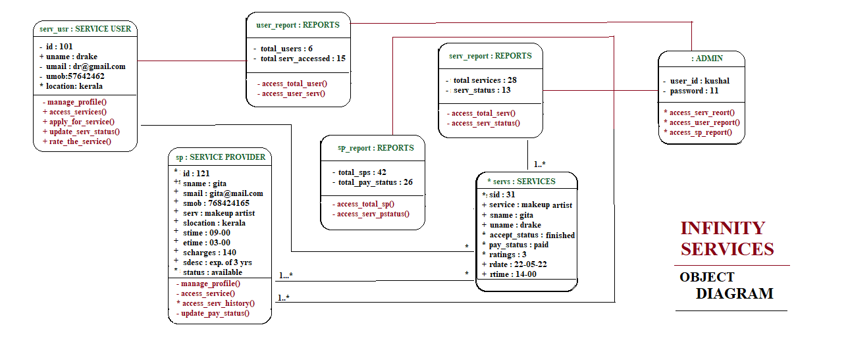
UML OBJECT DIAGRAM

Slide 20
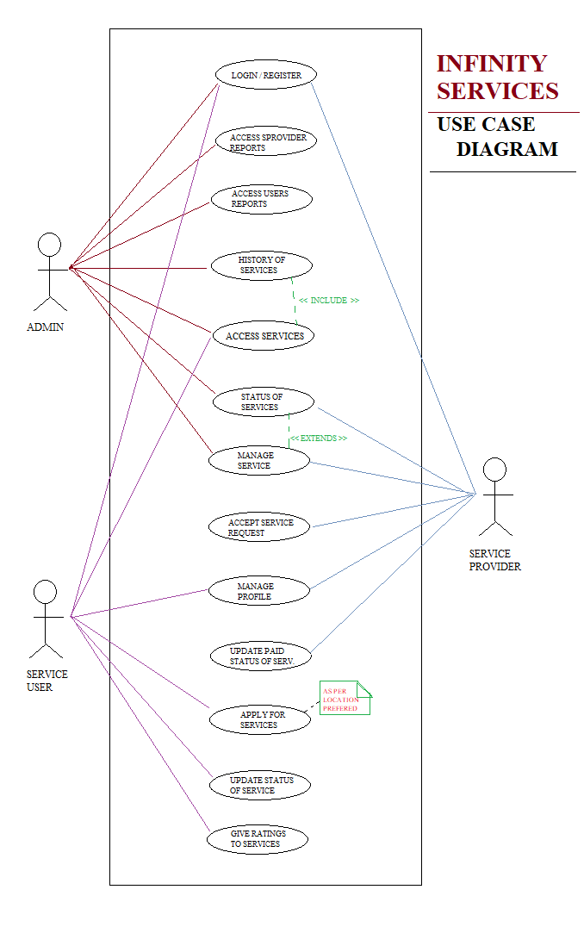
UML USE CASE DIAGRAM

Slide 21
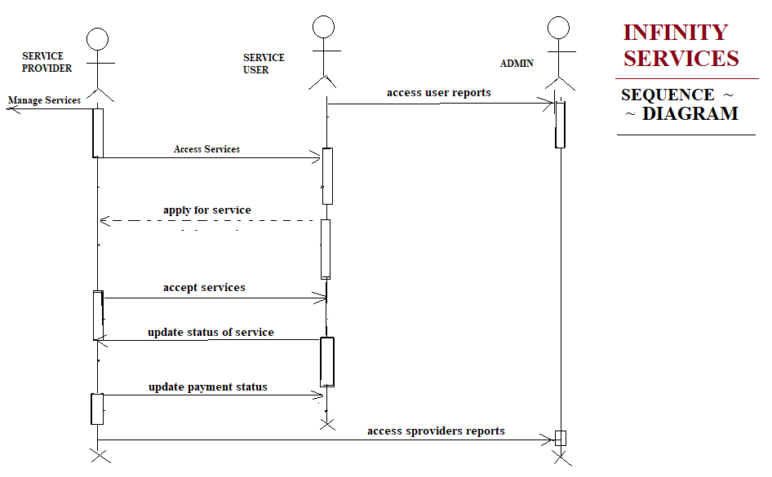
UML SEQUENCE DIAGRAM

Slide 22
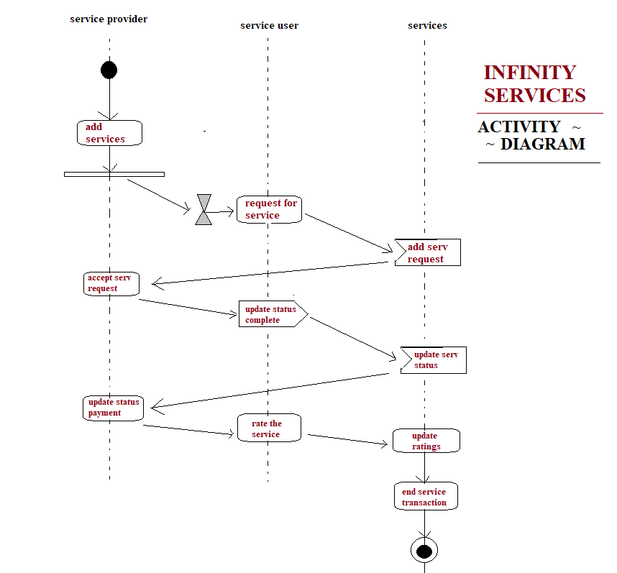
UML ACTIVITY DIAGRAM

Slide 23
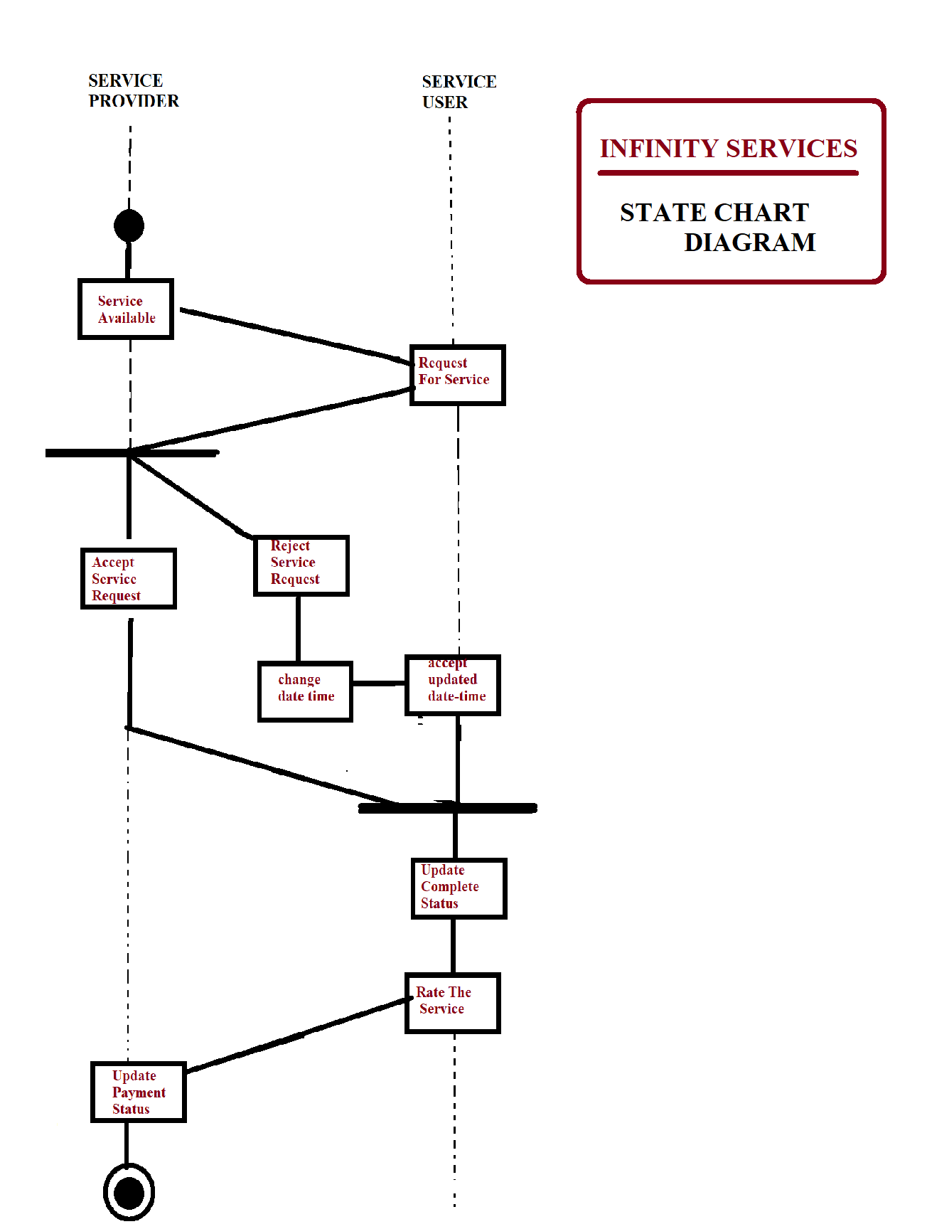
UML STATE CHART DIAGRAM

Slide 24
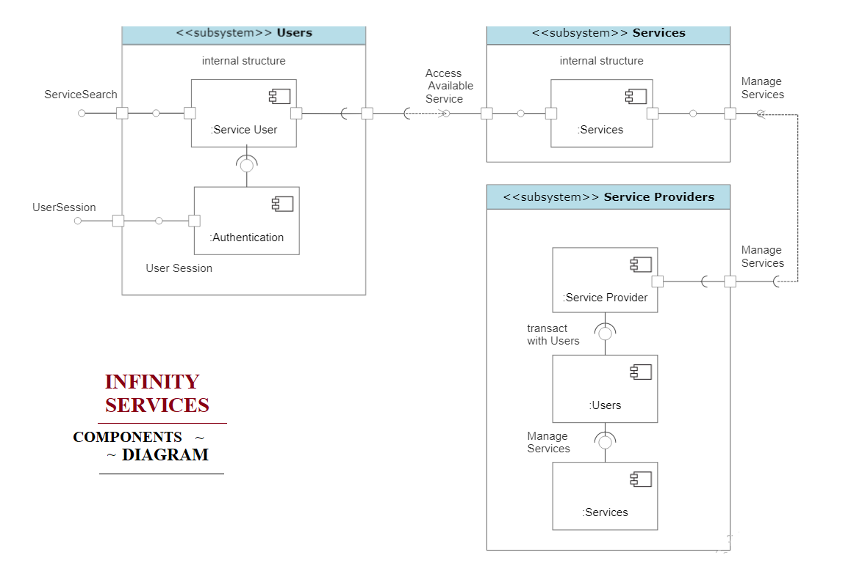
UML COMPONENTS DIAGRAM

Slide 25
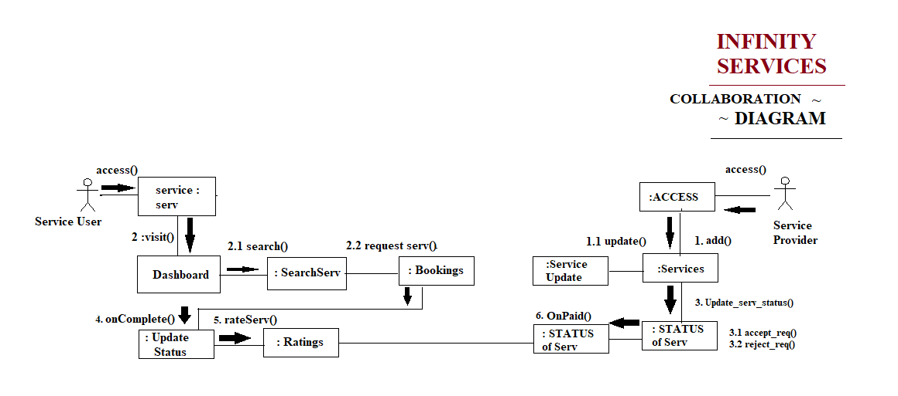
UML COLLABORATION DIAGRAM

Slide 26
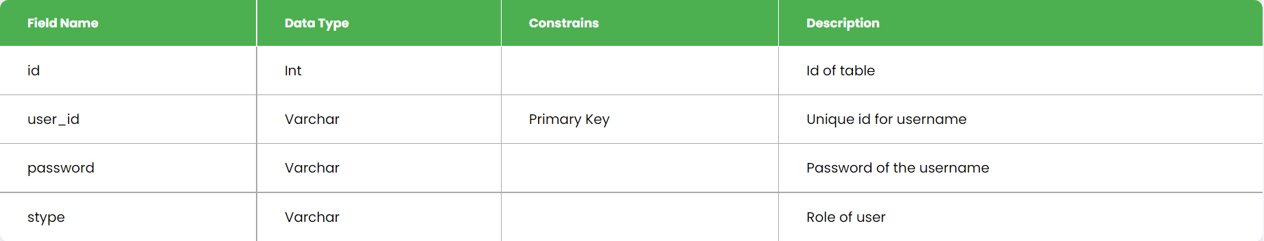
DATA DICTIONARY
Login:-

Slide 27
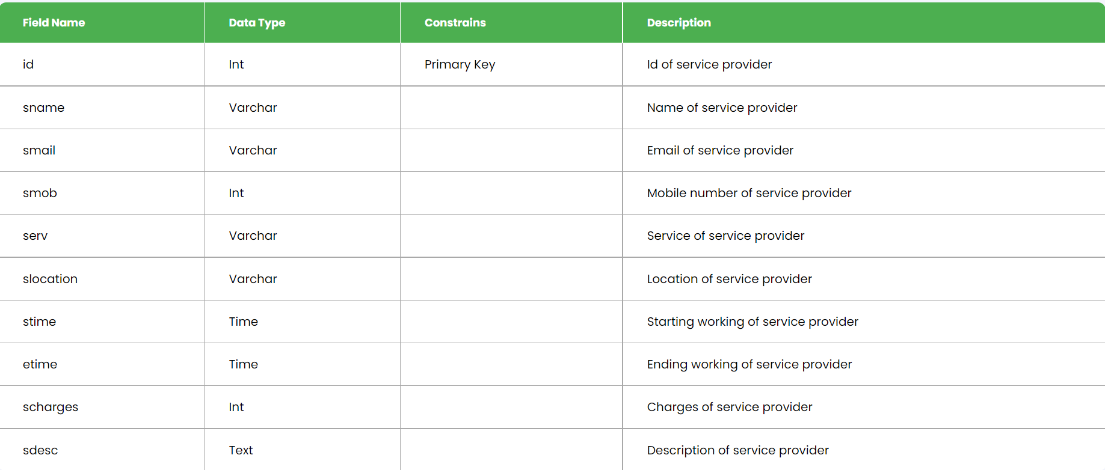
DATA DICTIONARY
Service provider:-

Slide 28
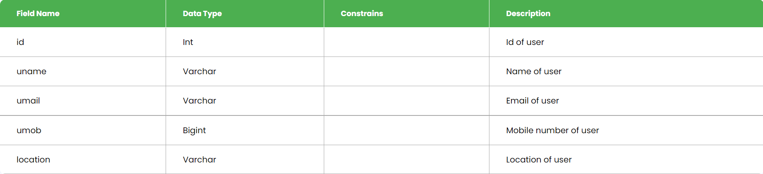
DATA DICTIONARY
User:-

Slide 29
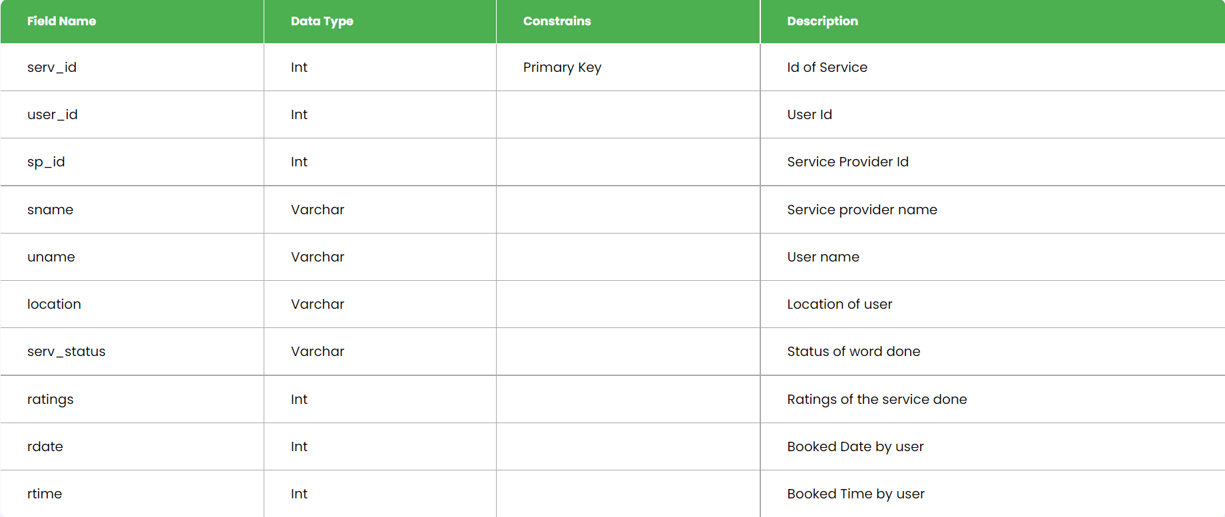
DATA DICTIONARY
Services:-

Slide 30
SCREENSHOTS

Slide 31
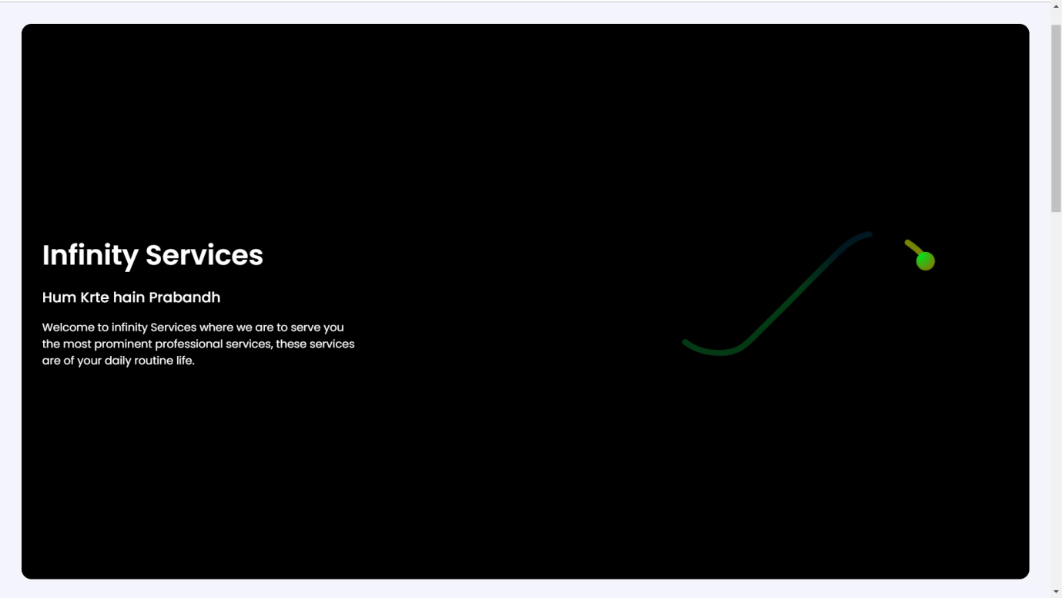

Slide 32
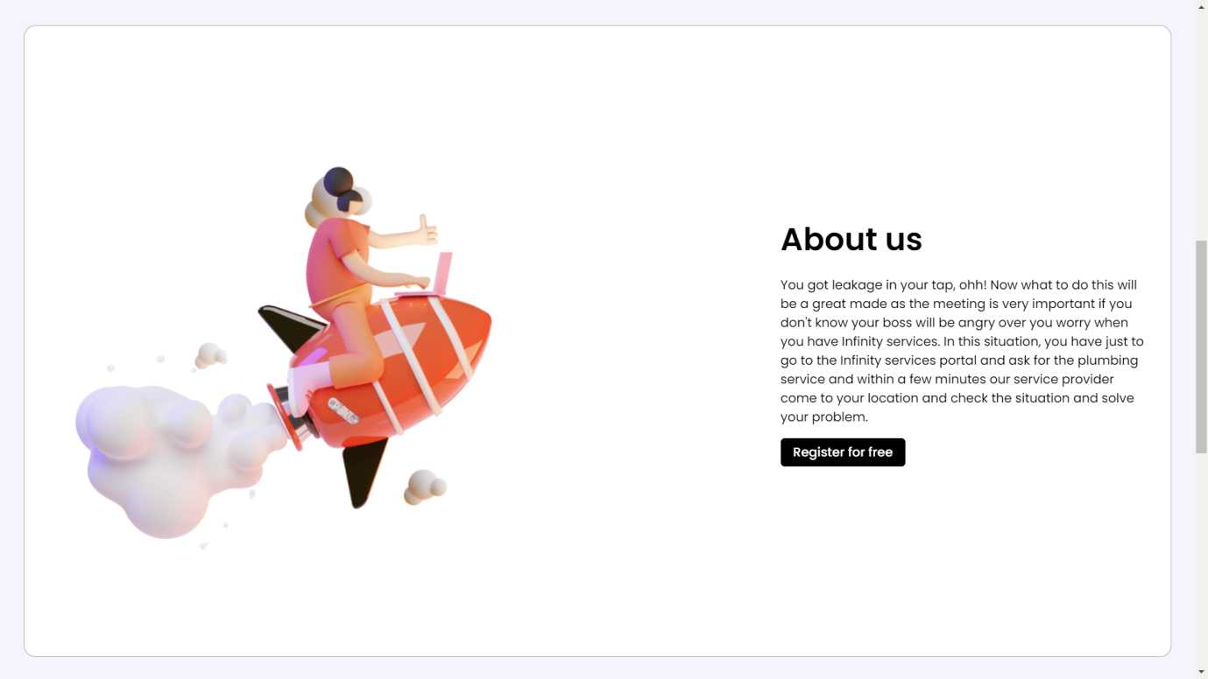

Slide 33
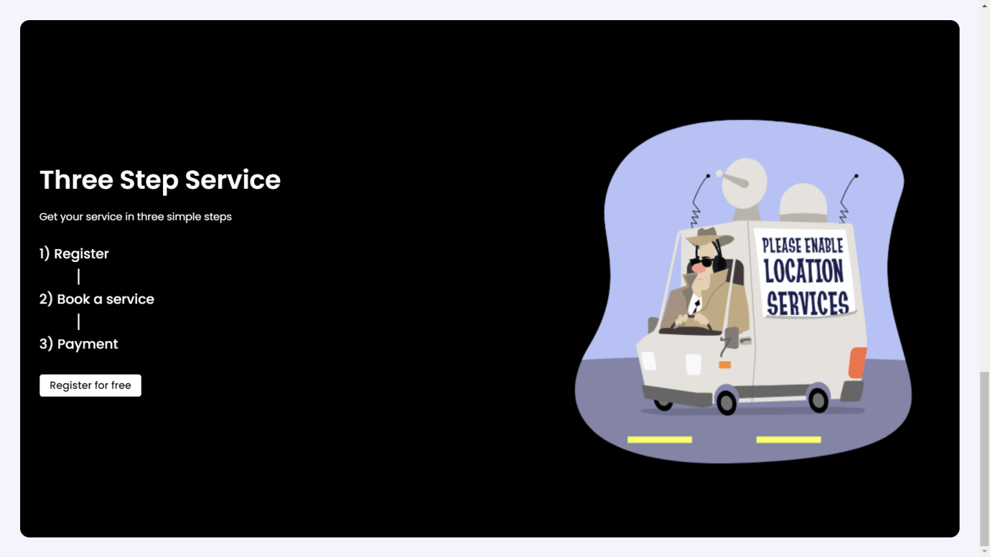

Slide 34
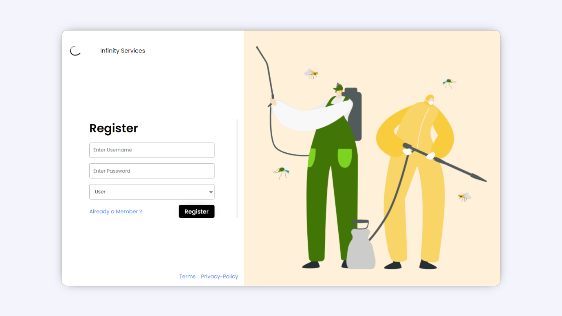

Slide 35
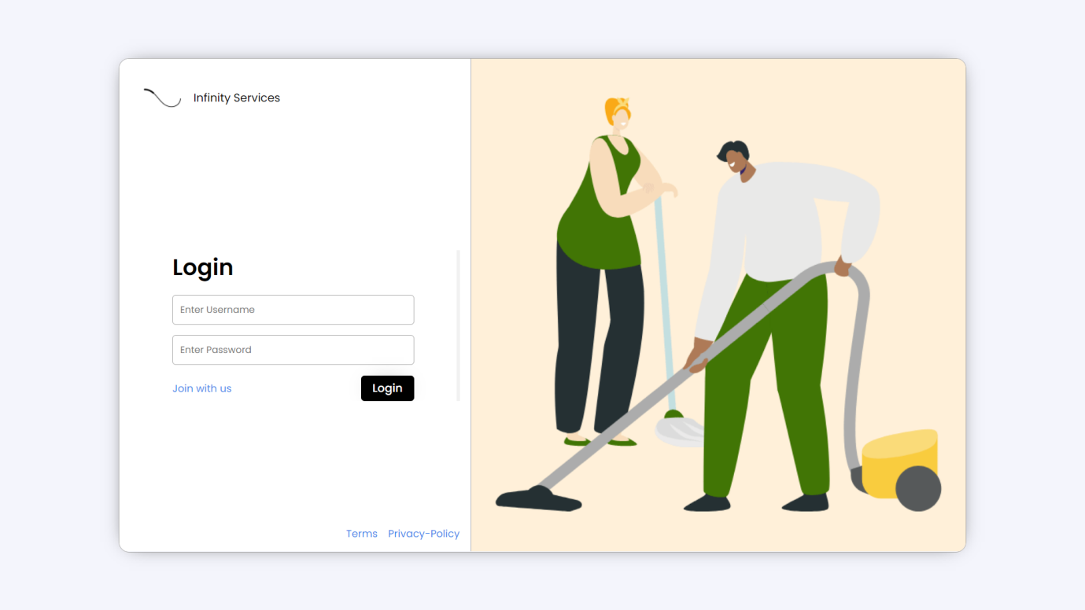

Slide 36
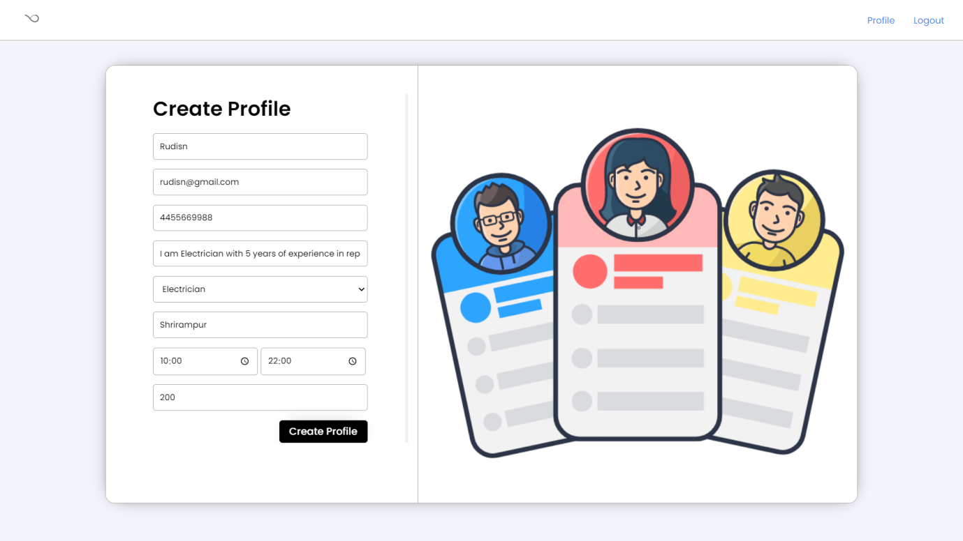

Slide 37
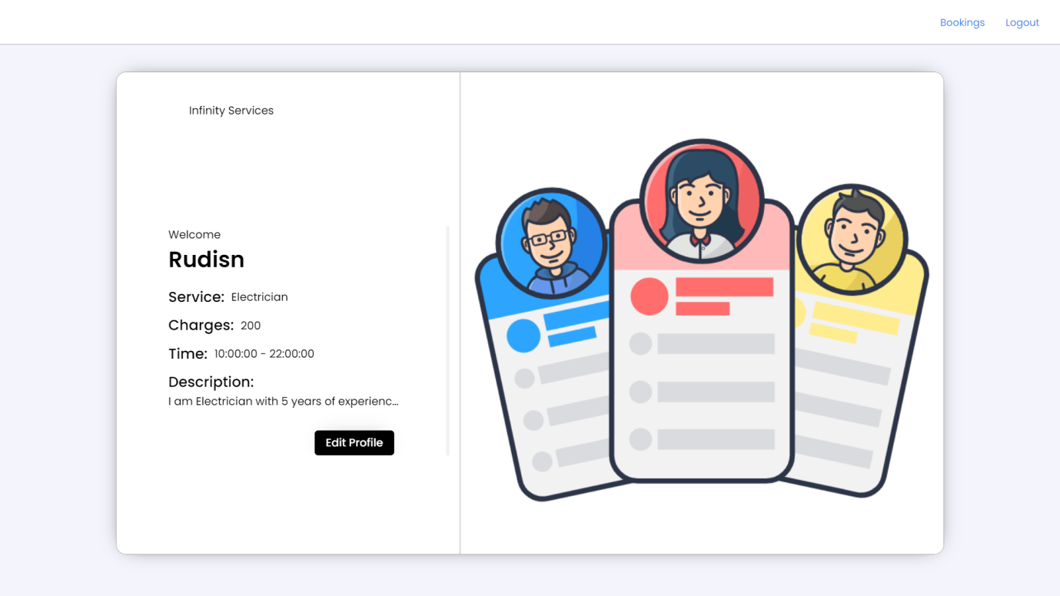

Slide 38
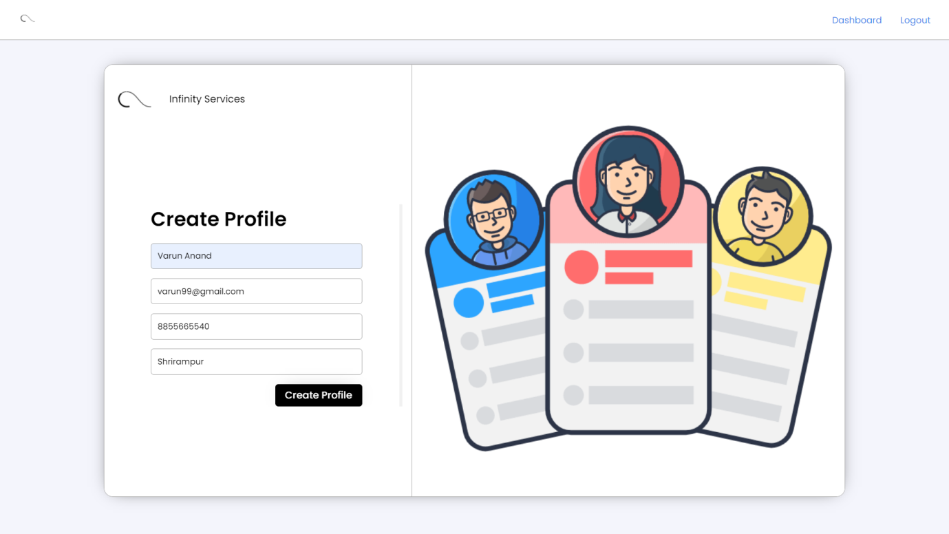

Slide 39
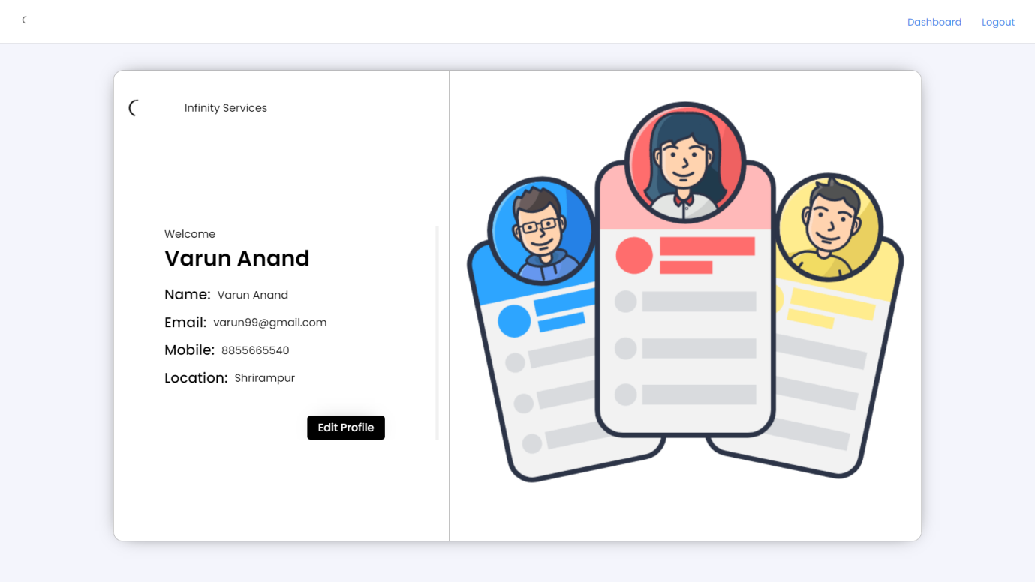

Slide 40
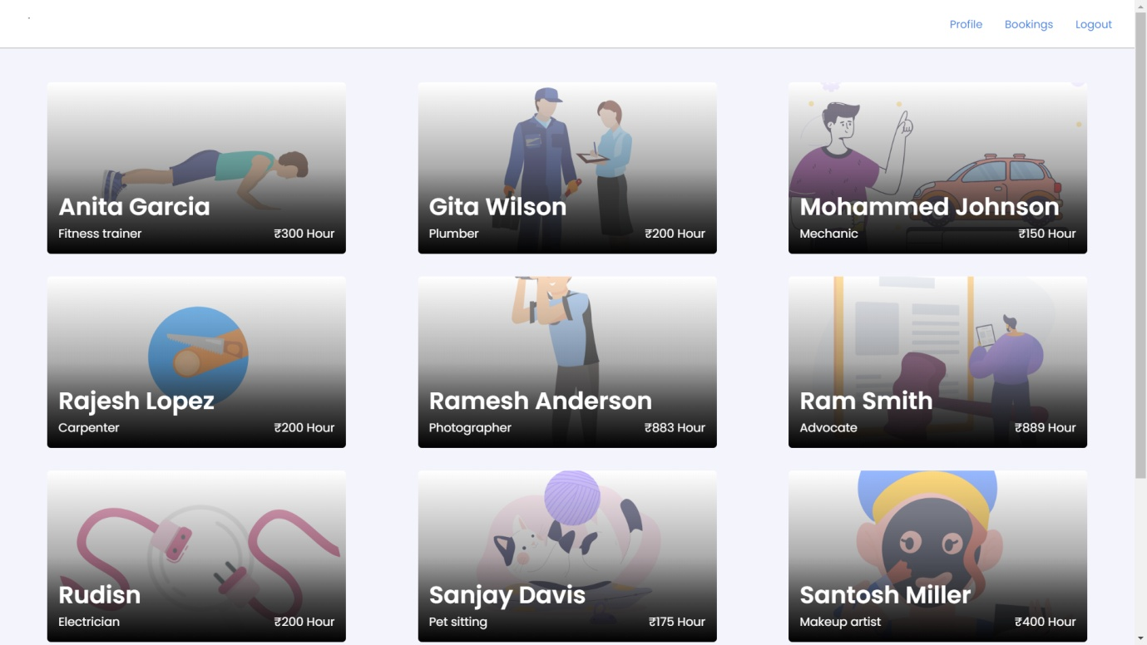

Slide 41
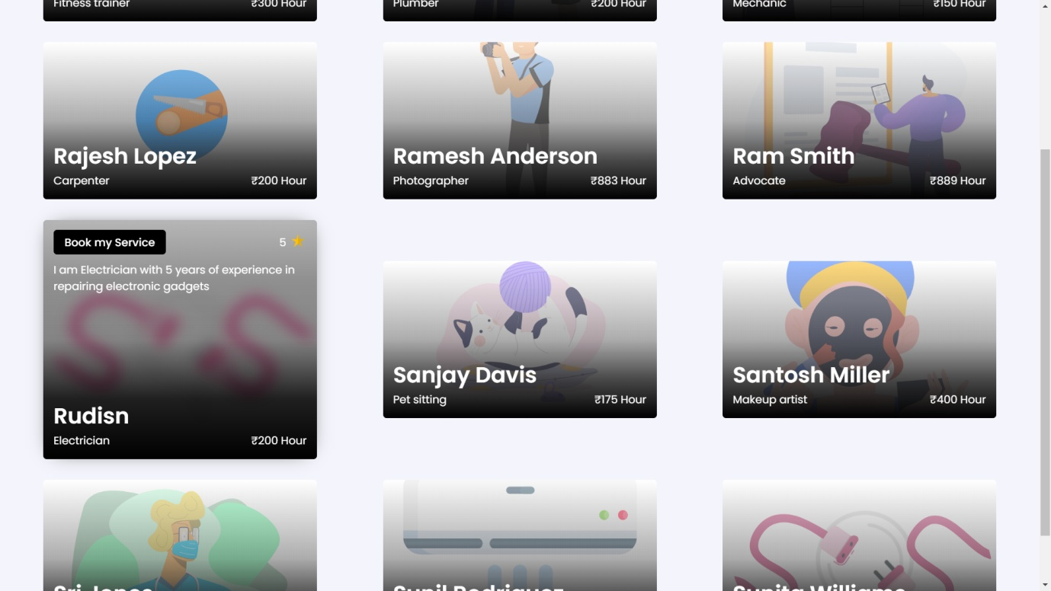

Slide 42
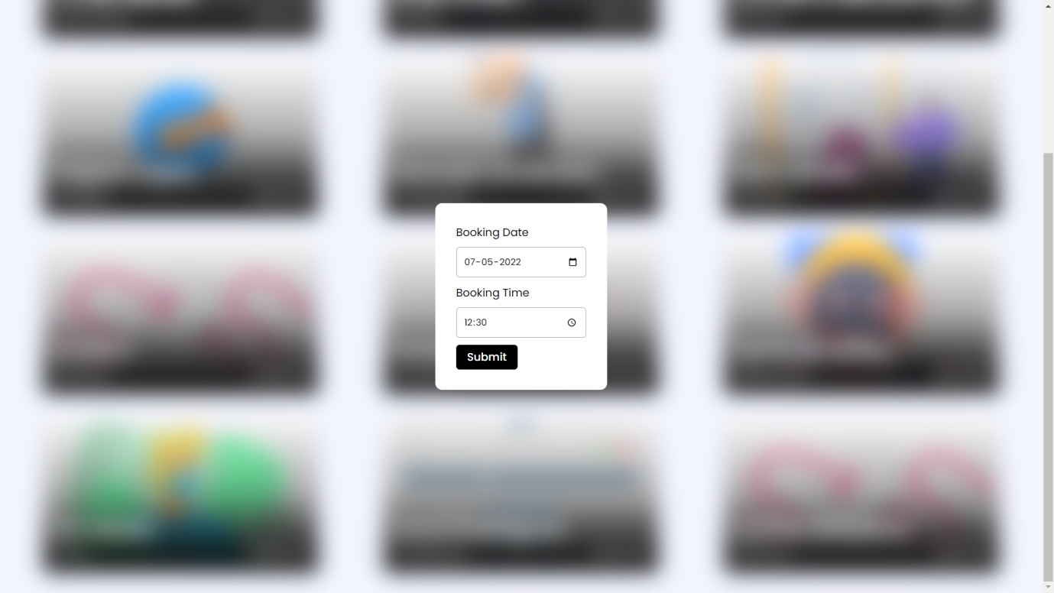

Slide 43
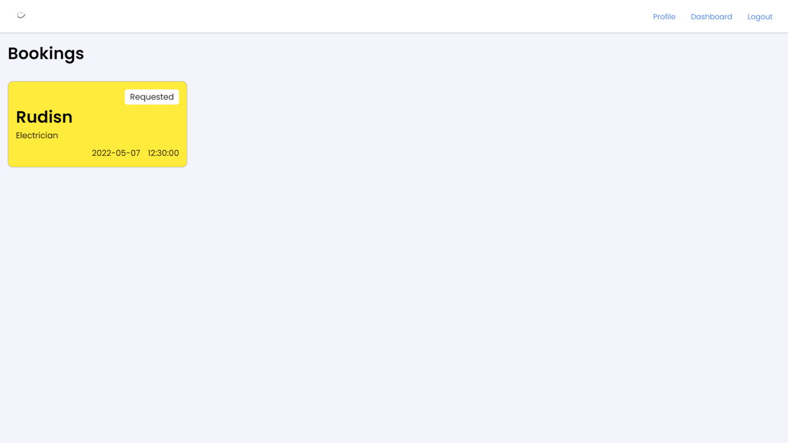

Slide 44
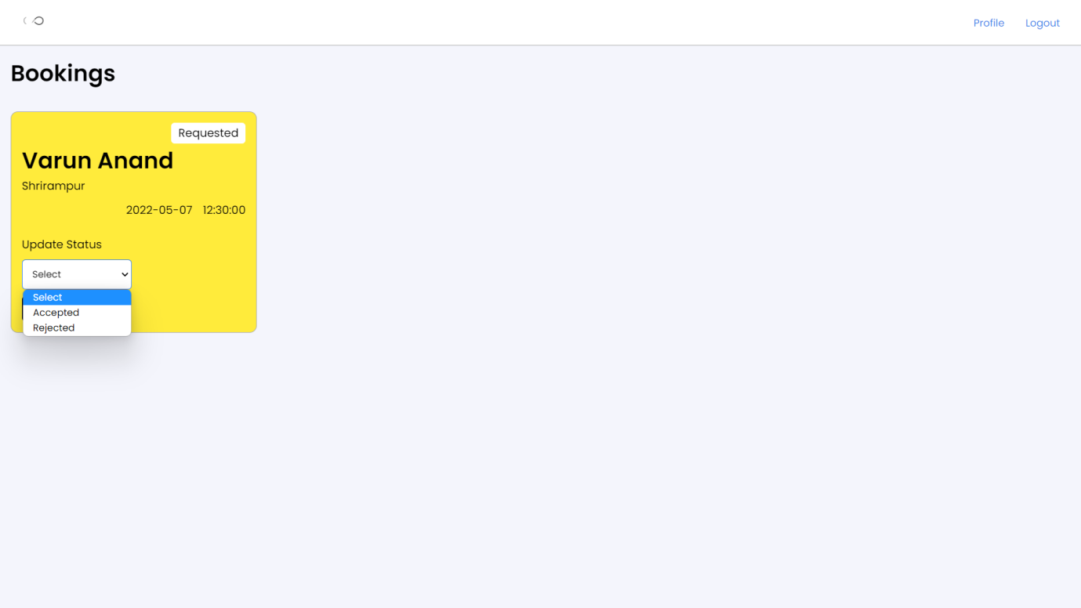

Slide 45
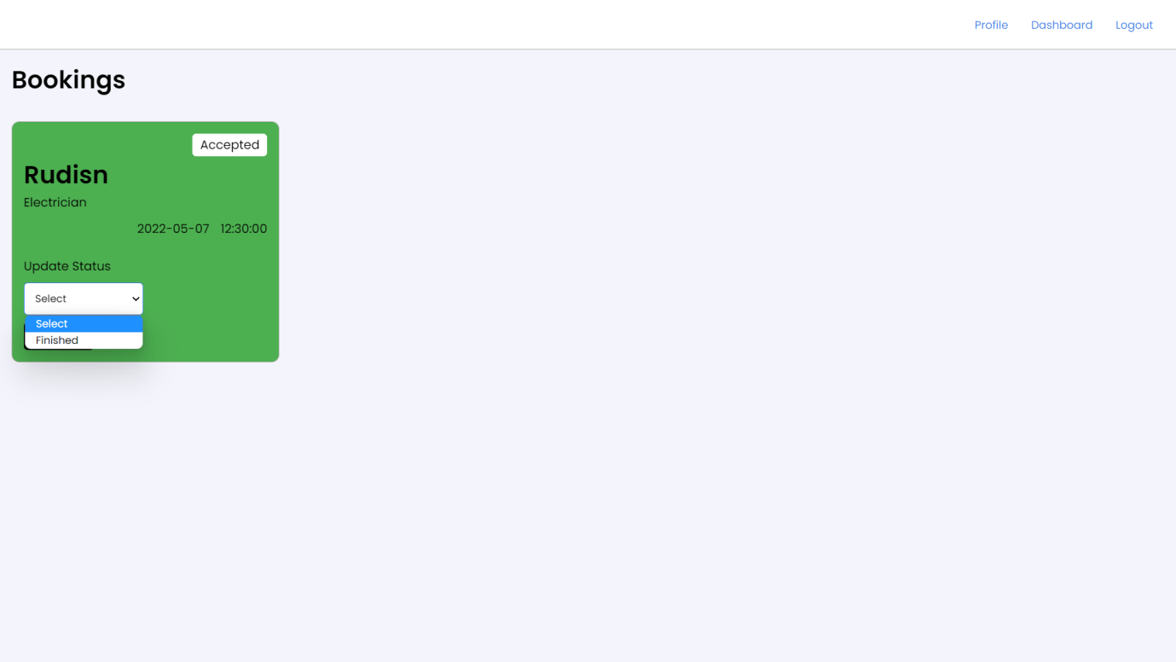

Slide 46
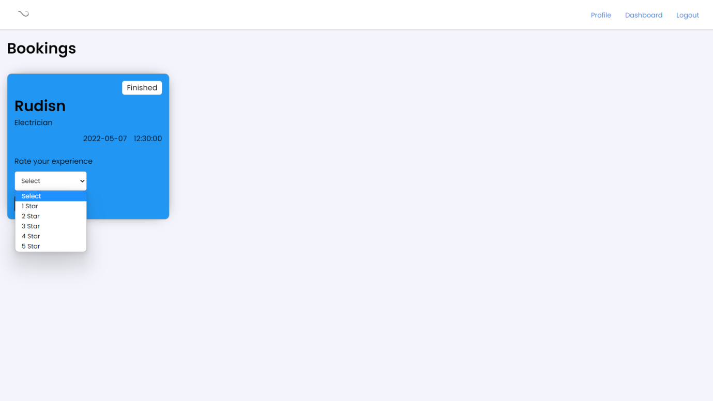

Slide 47
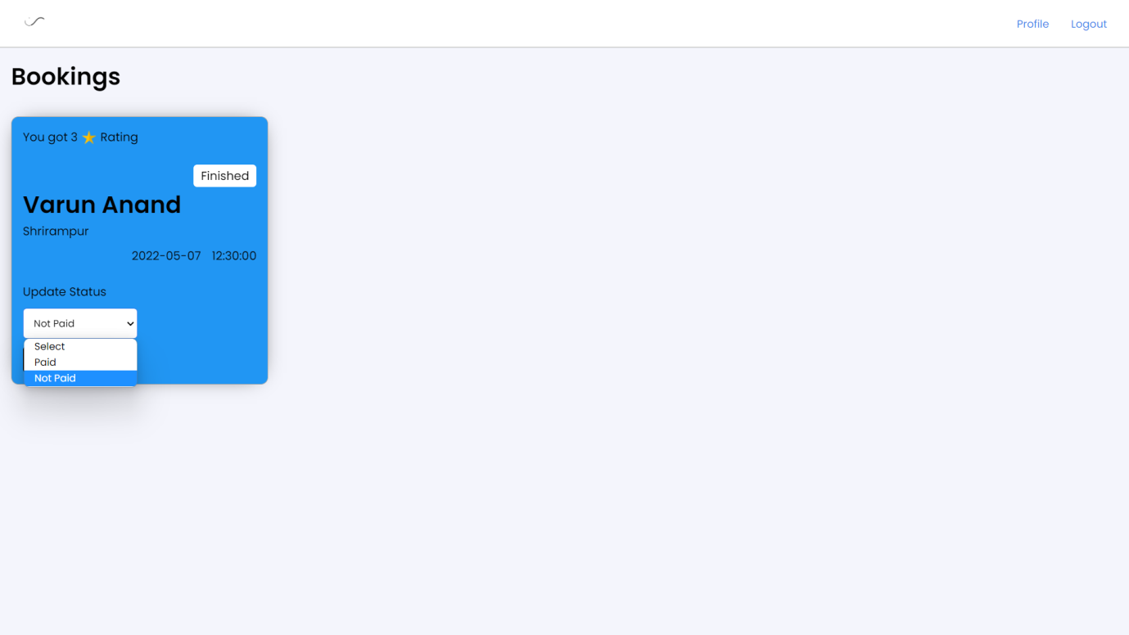

Slide 48
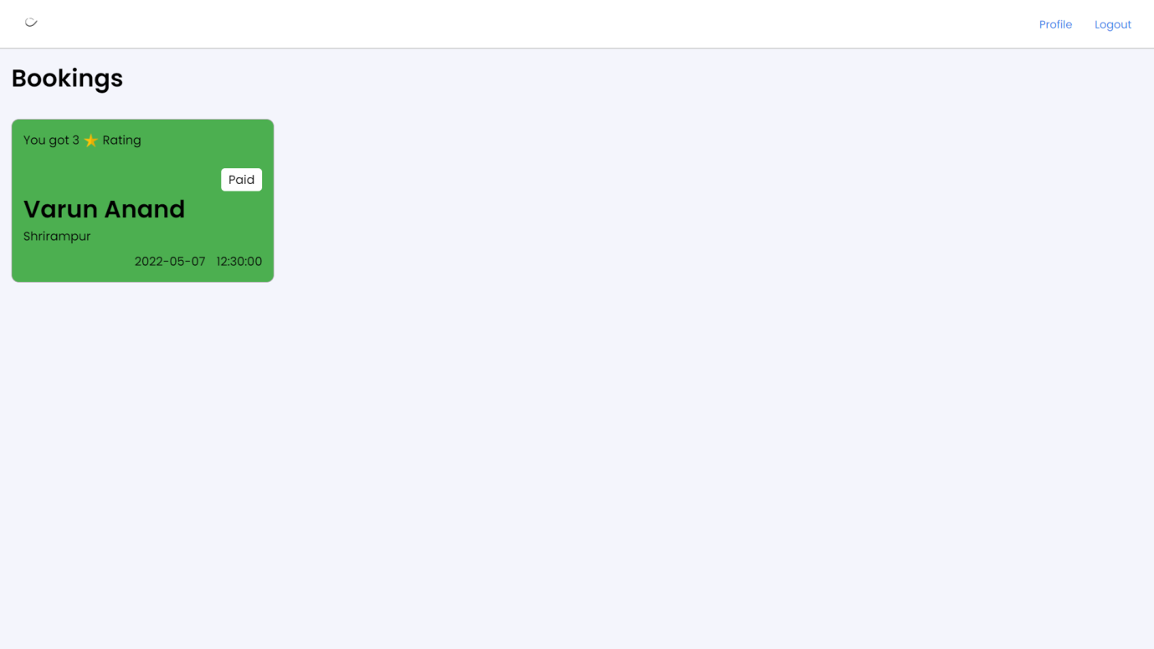

Slide 49
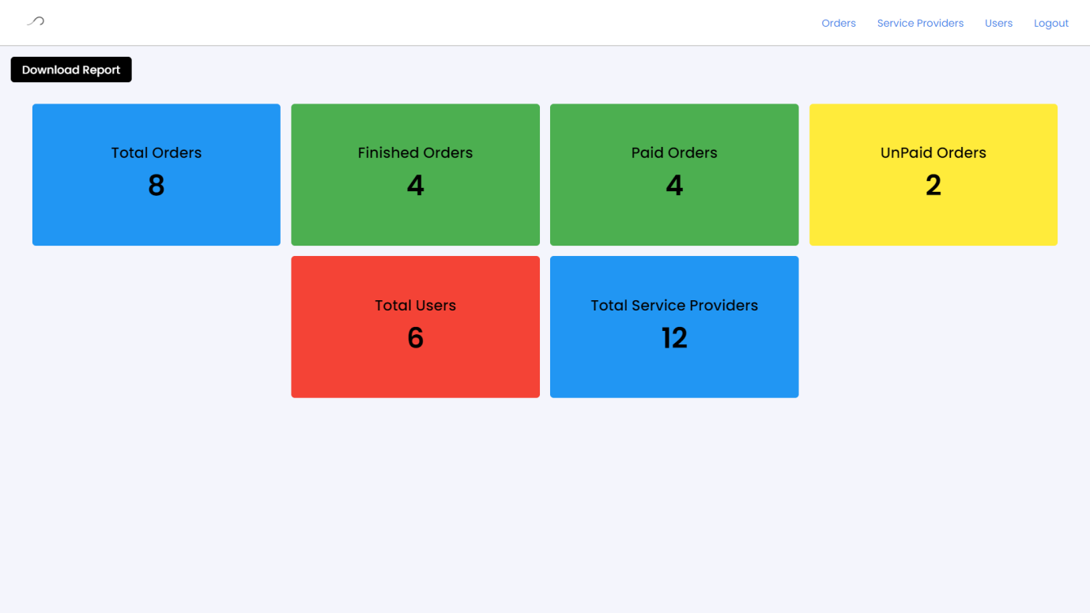

Slide 50
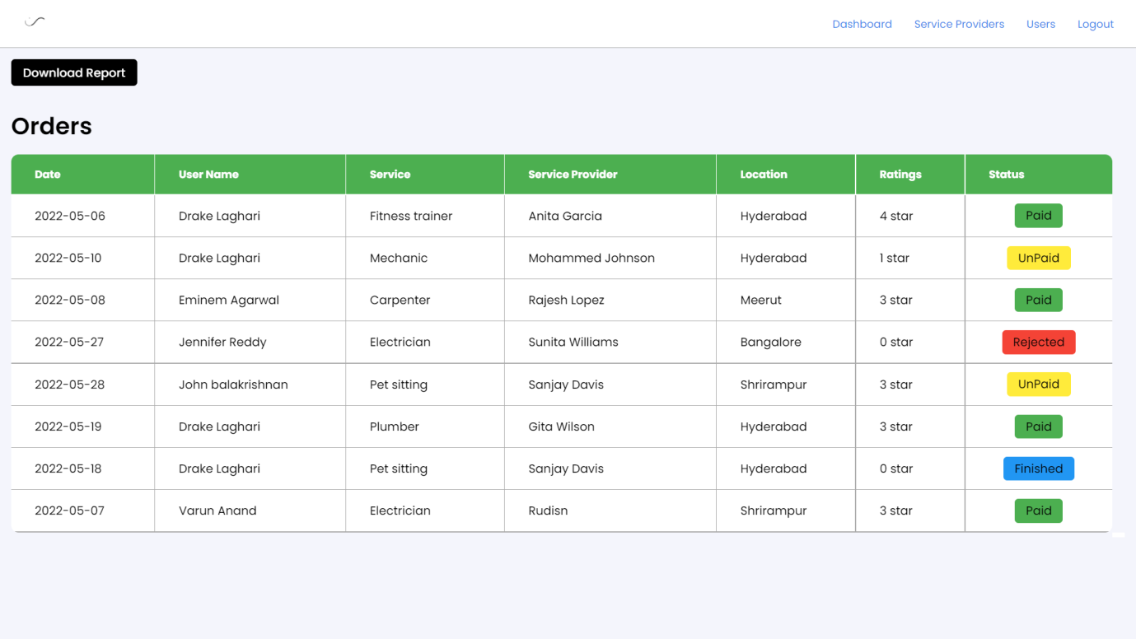

Slide 51
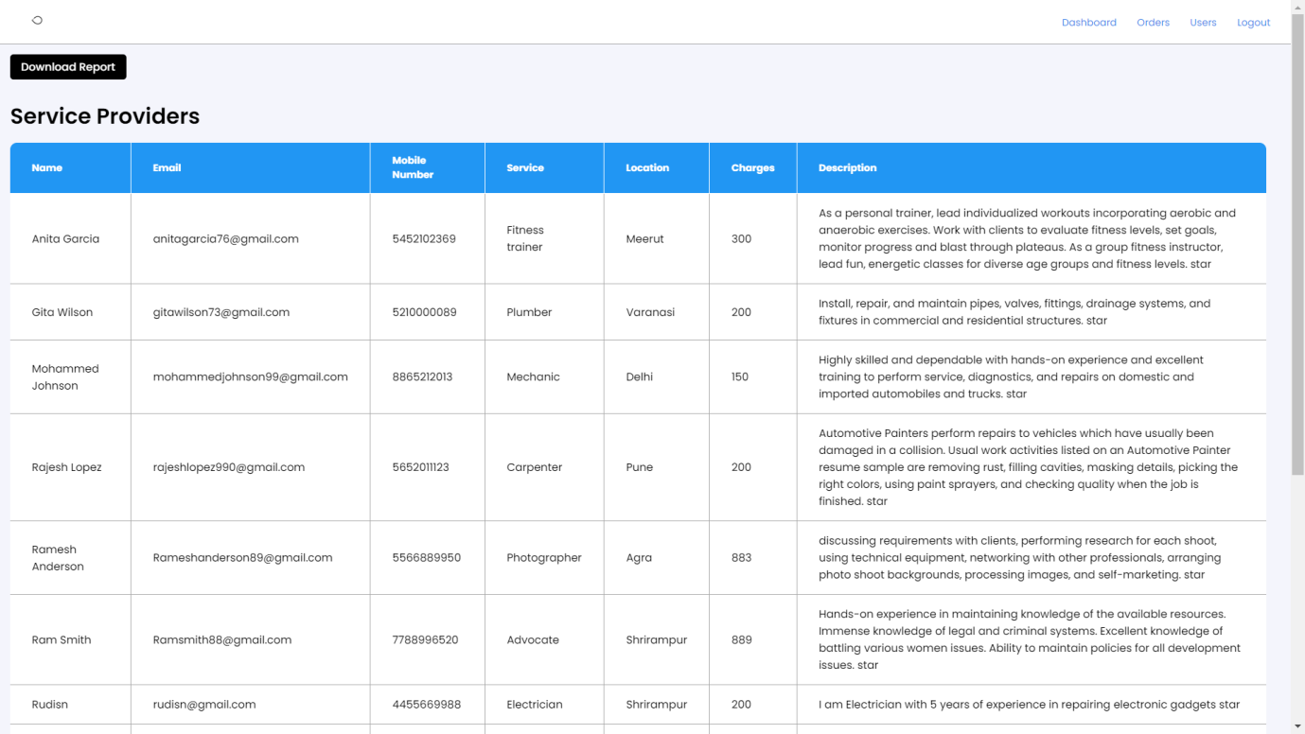

Slide 52
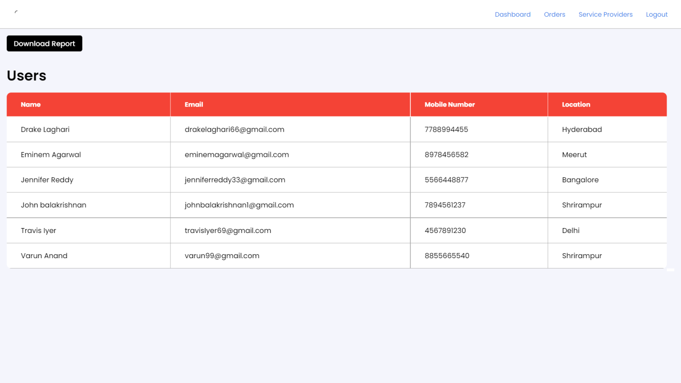

Slide 53
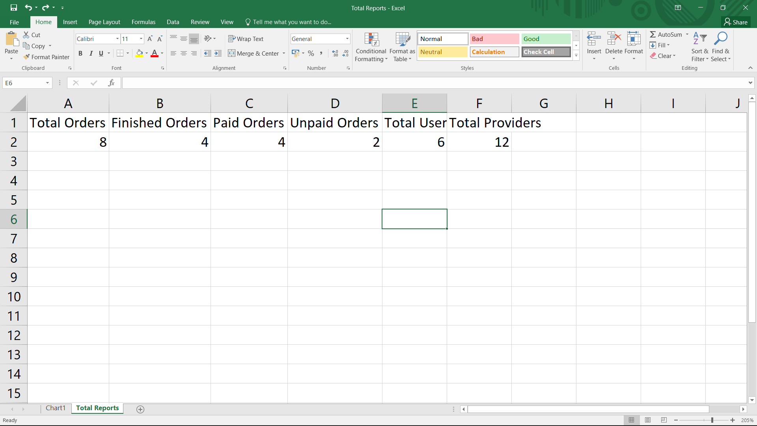

Slide 54
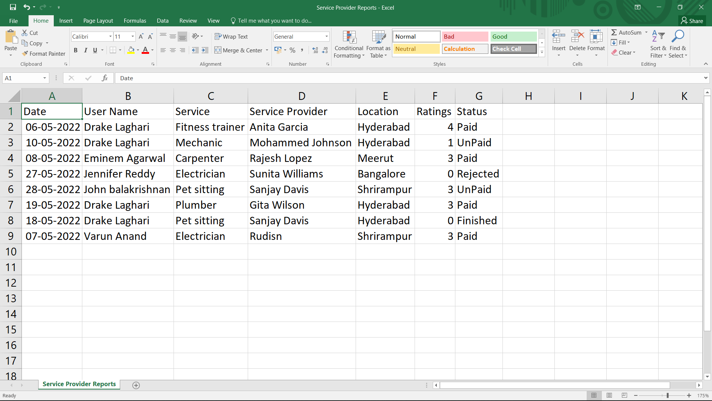

Slide 55
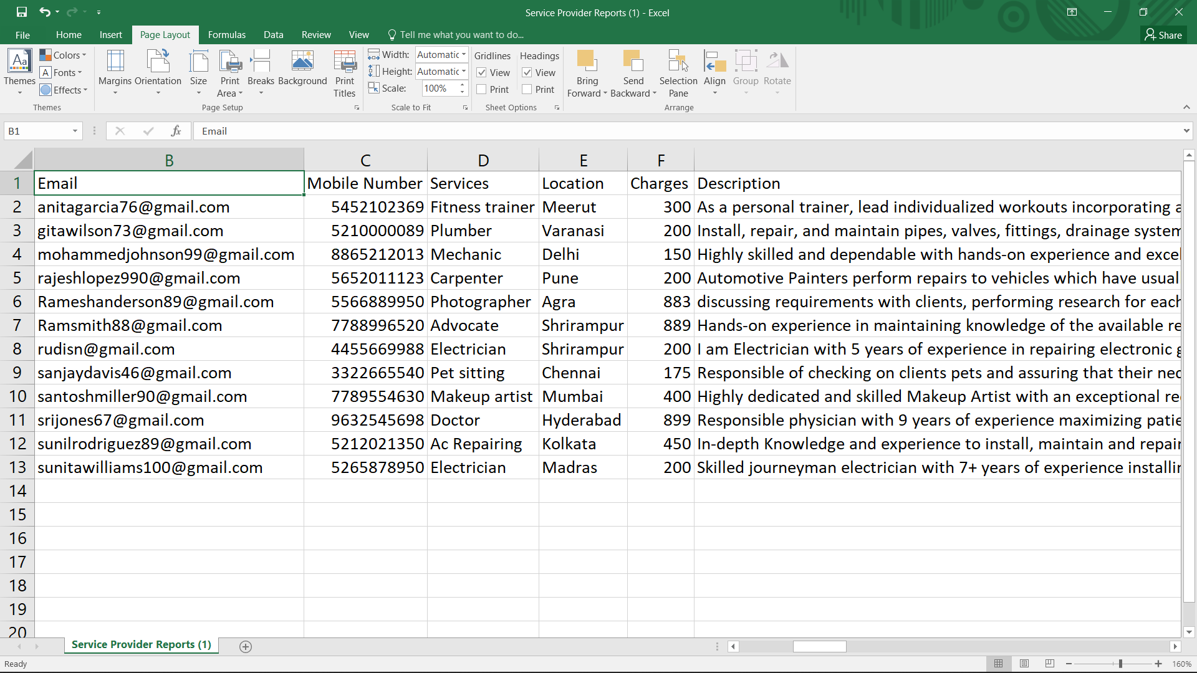

Slide 56
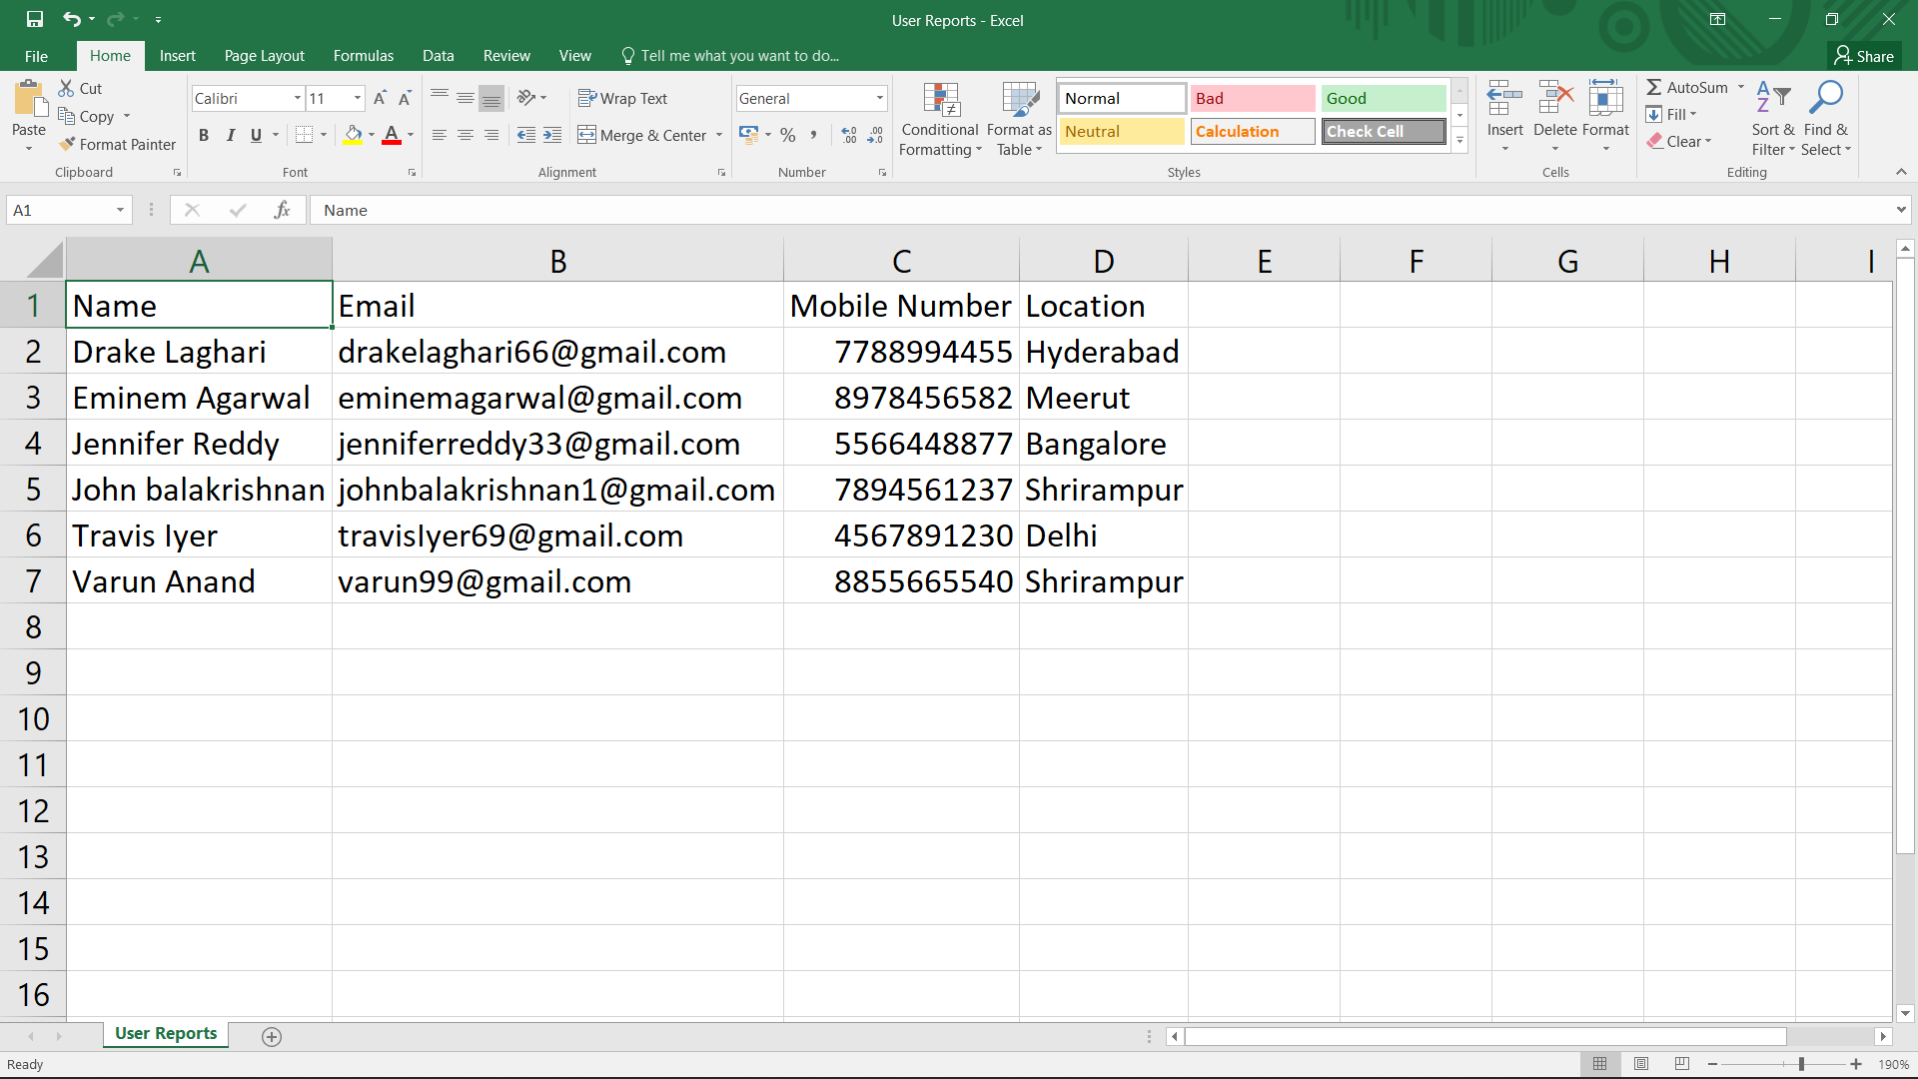

Slide 57
TEST PLAN
1 Introduction:-
For our project , testing is not 100% exhausted as it is principle of software testing .Our main focus would be on GUI Testing as our project is a web application where is users have highly interaction direct with website . In short , we prefer to functional testing rather than non-functional testing . testing be like load testing , compatibility testing and etc are exceptions in our scope of testing scenario .
1.1 Scope:-
1.1.1 In Scope:-
An in-scope for testing of AUT, is functional requirements validation and testing using white-box approach .
1.1.2 Out of scope:-
Out Of Scope defines the features, non-functional requirements of the software that will NOT be tested

Slide 58
TEST PLAN
1.2 Quality Objective:- Here make a mention of the overall objective that you plan to achieve without your testing Some objectives of your testing project could be
Ensure the Application Under Test conforms to functional and non-functional requirements
Ensure the AUT meets the quality specifications defined by the client
Bugs/issues are identified and fixed before go li

Slide 59
TEST PLAN
1.3 Roles and responsibilities:-
Detail description of the Roles and responsibilities of different team members like
QA Analyst , Developers
2 Test Methodology:-
2.1 Overview
Waterfall model:- As this project is at an academic level , rather making development more complex decided to go with traditional approach of Waterfall model . Where we first go through all the steps of development from the methodology and now at testing phases we are moving ahead .

Slide 60
TEST PLAN
2.2 Test levels:-
Test Levels define the Types of Testing to be executed on the Application Under Test (AUT). The Testing Levels primarily depends on the scope of the project, time and budget constraints.
Time Duration is about a week as per recommended by college for testing . and our budget over testing is with no-cost so we preferred manual testing than using automated testing using software like Selenium , Jira , Load runner, etc . levels are as first of all to do GUI testing and after then move to functional testing .
Bug Tria:-
To define the type of resolution for each bug
To prioritize bugs and determine a schedule for all ‘To Be Fixed Bugs’.

Slide 61
TEST PLAN
2.4 Test completeness
Here you define the criteria that will deem your testing complete. For instance, a few criteria to check Test Completeness would be
100% test coverage
All Manual Test cases executed
All open bugs are fixed or will be fixed in next release

Slide 62
TEST PLAN
3 Test Deliverables:-
Here mention all the Test artifacts that will be delivered during different phases of the testing lifecycle.
Test Plan
Test Cases
Bug Reports
Customer Sign Off

Slide 63
TEST PLAN
4 Resource and environment needs
4.1 Testing tools:-
No external tools are used as like Jira or selenium , test cases , bug reports are designed in MS Office 2007.
4.2 Test environment:-
It mentions the minimum hardware requirements that will be used to test the Application.
Following software’s are required in addition to client-specific software.
Windows 8 and above
Office 2007

Slide 64
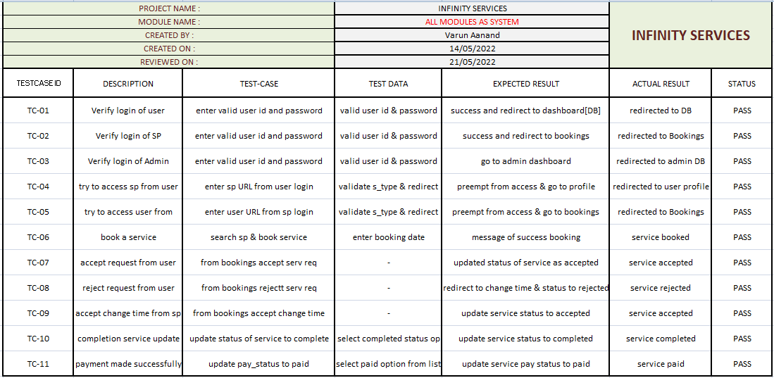
TEST CASES

Slide 65
Conclusion and recommendations
In summary, the project works are relevant to the objectives set. The project is designed based on a preliminary study that had been carried on with NITL. Thus activities of developing the system which is planning and analysis are based on the result retrieved from the interview on observation. Not only that, as this would be the first computerized system that will be used by the small service providers, the functions only focused on solving the major problem which is not finding quality service at an aggressive price. The interface design is also categorized as user-friendly due to the lack of IT background of the service providers which means the system can be handled by people not even from an IT background. Due to time constraints, the developer can't implement many functions in the system, thus the developer has few future works suggestions for continuation.

Slide 66
future scope
Location wise services.
Payment gateway.
Cloud services.
UI/UX update as per feedback.
Add more services for user.
AL & ML for service provider for getting the right data that in which location which service is needed.

Slide 67
Bibliography
Web Development – Andy Vickler
Php & MySQL: Server side web development – Jon Duckett

Slide 68
references
Web security study: https://github.com/topics/session-hijacking
PHP study: https://www.youtube.com/c/CodeWithHarry/videos

Slide 69
Thank you

